Slide 1



2019
Netcoreconf
DECOUPLING YOUR APPLICATION WITH .NET CORE, AZURE AND EVENTS
Carlos Mendible
Azure Evangelist @ everis
@cmendibl3
28/09/2019

Slide 2
Sponsors

Slide 3



I WILL NOT TALK ABOUT
Notes:
Esta claro que cualquiera de los temas que muestro en esta slide son topicos interesantes, pero no os voy a dar la chapa con docker, k8s, DevOps o política.

Slide 4
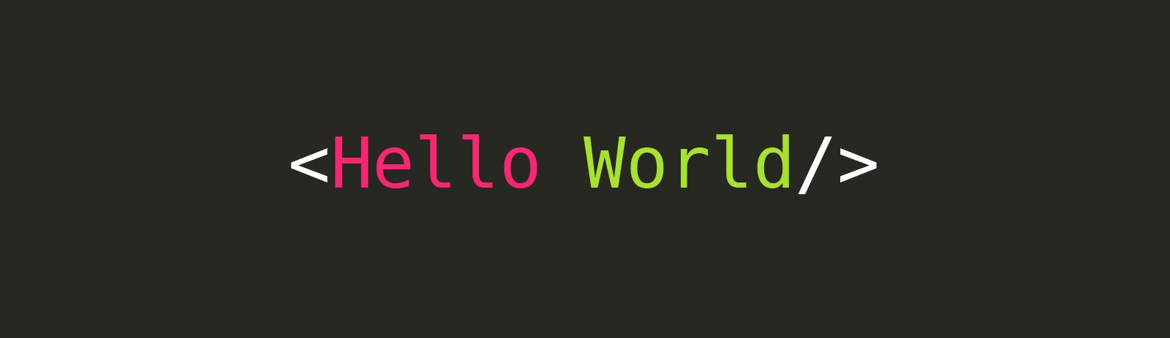
Decoupling Applications
Notes:
- Que es lo tipico cuando creamos aplicaciones? Pues que comenzamos con algo simple, quizas un portal con una quizas dos fuentes de datos.
Your application starts simple
One or may be two data sources
One backend
We all know what a Monolith is right?
Who avoids premature optimization?

Slide 5
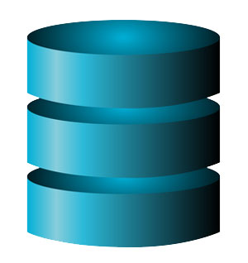
Decoupling Applications
Notes:
- Luego lo complicamos con quizás con una dos fuentes de datos.

Slide 6
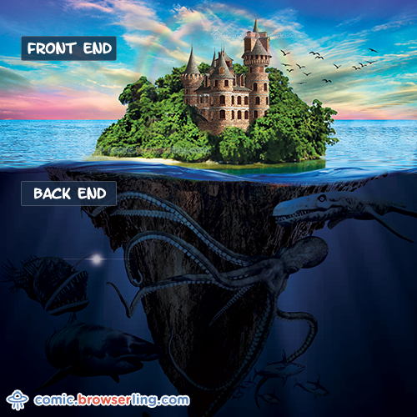
Decoupling Applications
Notes:
- Esto le llamamos backend

Slide 7
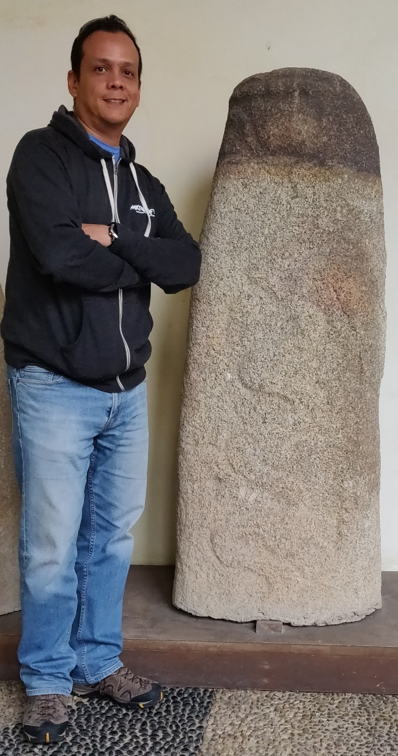

Decoupling Applications
Notes:
- Tienes un monolito, te sientes orgulloso de lo que has conseguido, no tienes limites! Te lo llevas a Azure!

Slide 8
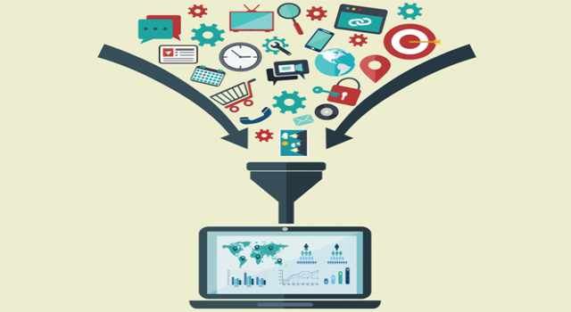
Decoupling Applications
Notes:
What if you need more data sources?

Slide 9
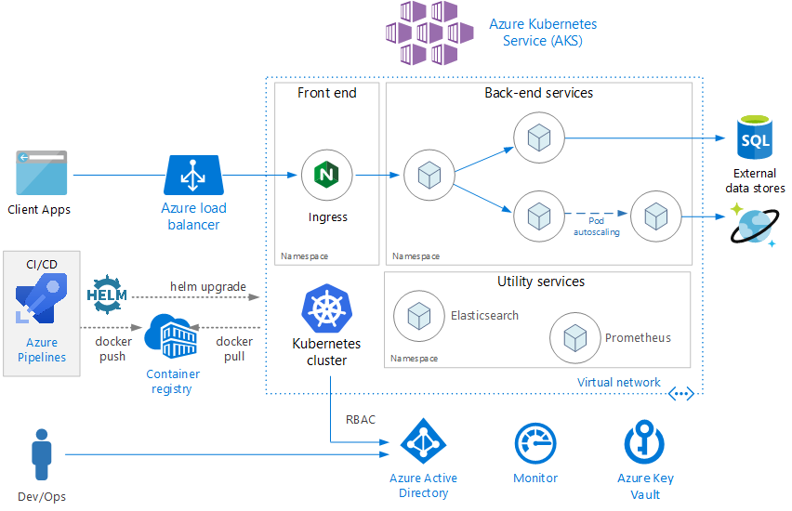
Decoupling Applications
Notes:
What if you need different backend process?
What happens when your system fails?
What about the scalability of both the system & your team?

Slide 10

Decoupling Applications
Notes:
What if you need different backend process?
What happens when your system fails?
What about the scalability of both the system & your team?

Slide 11
Event Driven Communications
Event Bus
Pub / Sub
Implementations:
Azure Service Bus
Azure Event Hubs
Kafka
RabbitMQ
Other

Slide 12
Events & Messages
Event: lightweight notification of a condition or a state change
Message: A message is raw data produced by a service to be consumed or stored elsewhere.
Notes:
- Event: lightweight notification of a condition or a state change. The publisher of the event has no expectation about how the event is handled. The consumer only needs to know that something happened.
- Message: A message is raw data produced by a service to be consumed or stored elsewhere. A contract exists between the two sides.

Slide 13
Comparision of Services
Service | Purpose | Type | When to use
Event Hubs | Big data pipeline | Event streaming (series) | Telemetry and distributed data streaming
Service Bus | High-value enterprise messaging | Message | Order processing and financial transactions
Event Grid | Reactive programming | Event distribution (discrete) | React to status changes

Slide 14
Azure Event Hubs
Distributed Data Streaming
A streaming service designed to do low latency distributed stream ingress
A partitioned consumer scale model
A time retention buffer
An elastic component in the middle of your chain

Slide 15
Azure Event Hubs
Stream millions of events per second
Process real-time and batch on same stream
Handle volume, variety and velocity of data
Notes:
- Stream millions of events per second
- Telemetry and logging
- Scale ingestion service
- Distributed streaming platform
- Process real-time and batch on same stream
- Event Hub Capture* to load data to Azure
- Batch processing
- Real time processing
- Handle volume, variety and velocity of data
- Fully-manage service
- Ingest events with elastic scale
- Accommodate variable load profiles

Slide 16
Kafka-enabled Event Hubs
Kafka Concept | Event Hubs Concept
Cluster | Namespace
Topic | Event Hubs
Partition | Partition
Consumer Group | Consumer Group
Offset | Offset

Slide 17
Kafka-enabled Event Hubs
Kafka Features not yet supported by Event Hubs
Idempotent producer
Transaction
Compression
Size -based retention
Log compaction
Adding partitions to an existing topic
HTTP Kafka API support
Kafka Streams
Notes:
- [Check](https://docs.microsoft.com/en-us/azure/event-hubs/event-hubs-for-kafka-ecosystem-overview)

Slide 18
Azure Event Hubs
Event Hub is the ideal service for telemetry ingestion from websites, apps and streams of big data

Slide 19


Slide 20
Azure Service Bus
Messaging as a Service
Rich features for temporal control
Routing and filtering
Transactions
Convoys & Sessions (related messages with state)

Slide 21
Azure Service Bus
Queues:
Sender sends message to queue
Queue ACKs receipt
Receiver connects to queue & retrieves message
Receiver ACKs complete (or other action)

Slide 22
Azure Service Bus
Pub / Sub
Sender only knows about Topic
Receivers only know about Subscriptions
Filters and Actions exist on Subscriptions

Slide 23
Features of a Service Bus
Scheduled delivery
Poison message handling
ForwardTo
Defer
Sessions
Batching
Ordering
Auto-delete on idle
OnMessage
Duplicate detection
Filters
Actions
Transactions

Slide 24

Features of a Service Bus

Slide 25
Event Grid
Fully-managed event routing
Near real-time event delivery at scale
Broad coverage within Azure and beyond
Backbone of event-driven computing

Slide 26
Event Grid
Event: what happened
Event Publisher: where it took place
Topic: where publishers send events
Event Subscriptions: routes & filters events
Filters: EventTypes, SubjectBeginsWith, SubjectEndsWith
Event Handlers: app or service reacting to the event

Slide 27
Event Grid Scenarios
Serverless Apps
Ops Automation
3rd Party Integration
Notes:
- Execute changes against a datastore
- Run a function to check compliance check on each newly created database.
- Use custom "drive starts" and "drive ends" events to log vehicle performance metrics

Slide 28
Eventual Consistency
A consistency model used in distributed computing to achieve high availability that informally guarantees that, if no new updates are made to a given data item, eventually all accesses to that item will return the last updated value.

Slide 30
Sponsors

Slide 31

Más información:
info@netcoreconf.com
@netcoreconf
Visítanos en:
netcoreconf.com
GRACIAS

